Slide 1
Unlocking Insights
Hotel Booking Data Exploration
Team Members
Amit Shendge
Chinmay Dhamapurkar
Nihar Domala
Shashank Shivakumar

Slide 2
Introduction
Data: Booking data for Major Hotel Chain
About the Data:
This dataset provides detailed insights into hotel bookings, capturing essential aspects like booking and arrival dates, customer demographics, distribution channels, and financial metrics such as average daily rates and revenue. Designed for in-depth analysis of hotel performance and customer behavior, it supports strategic business decisions by highlighting trends and operational efficiencies.
Objective:
Data Manipulation
Perform in-depth Exploratory Data Analysis (EDA) on the provided dataset
Identifying Key Variables
Statistical Inferences
Model Building

Slide 3
Dataset Overview
Numerical | Categorical
Lead Time | Hotel
Nights | Distribution Channel
Guests | Customer Type
Avg Daily Rate | Country
Cancelled (0/1) | Deposit Type
Revenue | Status
Revenue Loss
Booking ID
Booking Year
Dimensions of data:
119390 rows, 17 columns
Unique Identifier: Booking ID
Column name | No. of. missing values
Country | 488

Slide 4
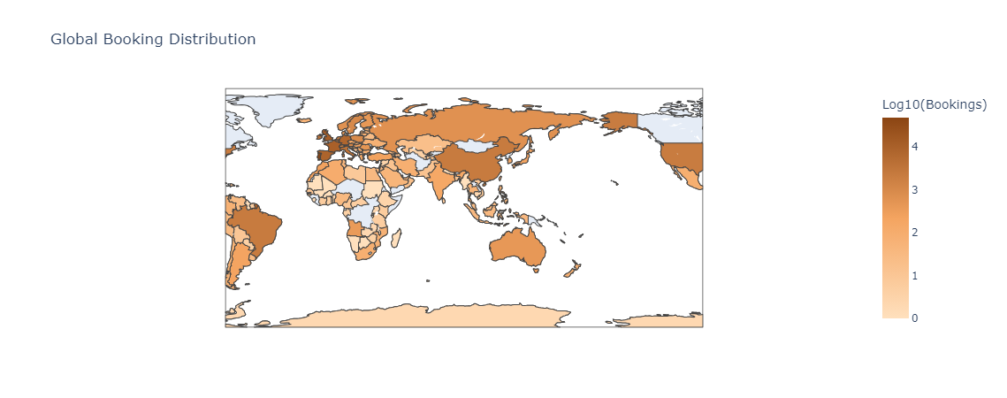
Where the World Chooses to Stay?
Product 1
Venus is the second planet from the Sun
Product 2
Saturn is composed of hydrogen and helium

Slide 5
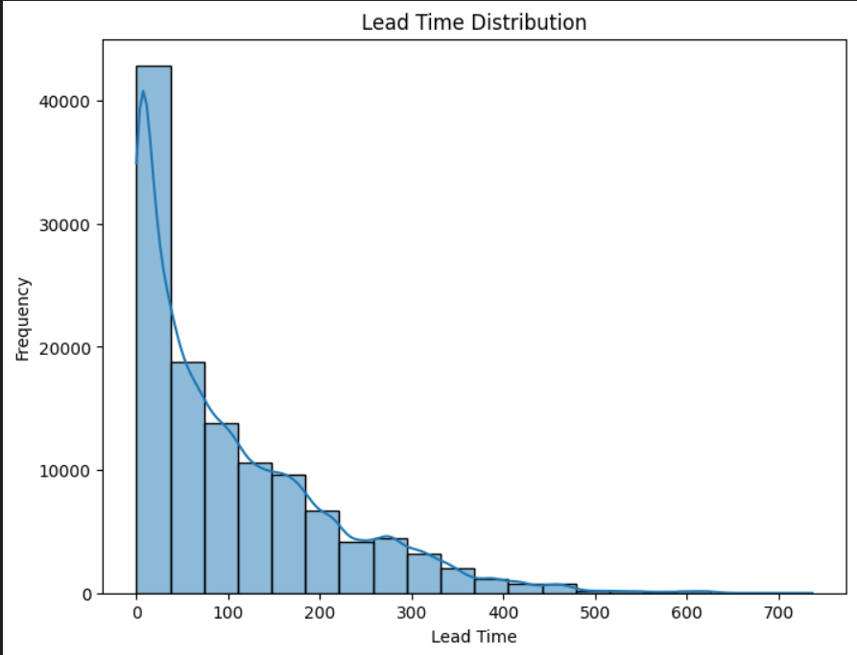
How Early Do Travelers Plan Their Journeys?

Slide 6
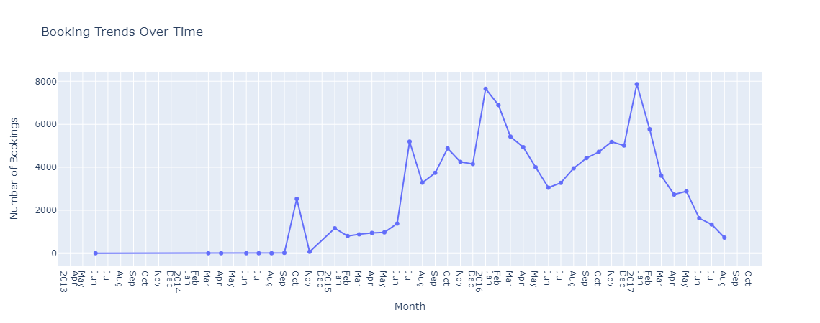
Through the Calendar: What Do Booking Patterns Tell Us About Traveler Habits?
50%
60%
Venus
Mars
Venus has a beautiful name and is the second planet from the Sun
Despite being red, Mars is a cold place full of iron oxide dust
70%
80%
Mercury
Jupiter
Mercury is the closest planet to the Sun and the smallest one
Jupiter is a gas giant and the biggest planet in the Solar System

Slide 7
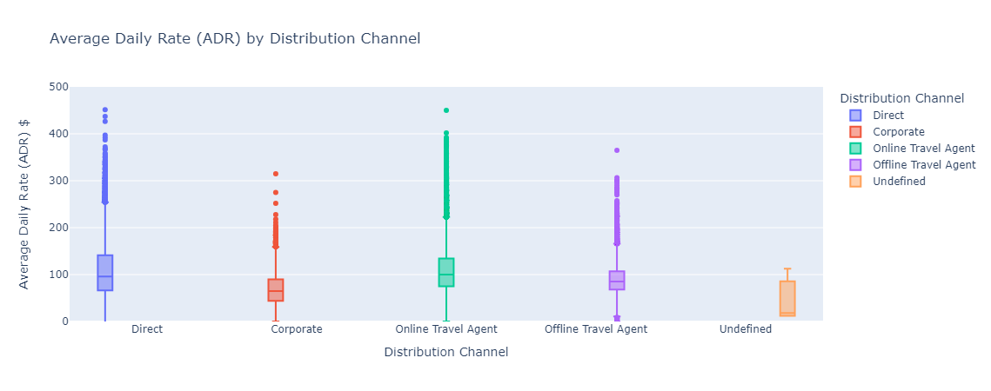
Price Points: How Do Distribution Channels Shape the Cost of Your Stay?
Product 1
Product 2

Slide 8
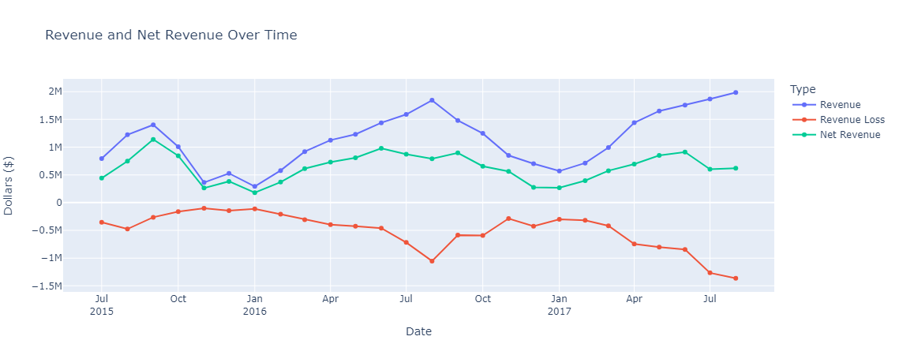
The Revenue Rollercoaster: Riding the Ups and Downs of Financial Performance

Slide 9
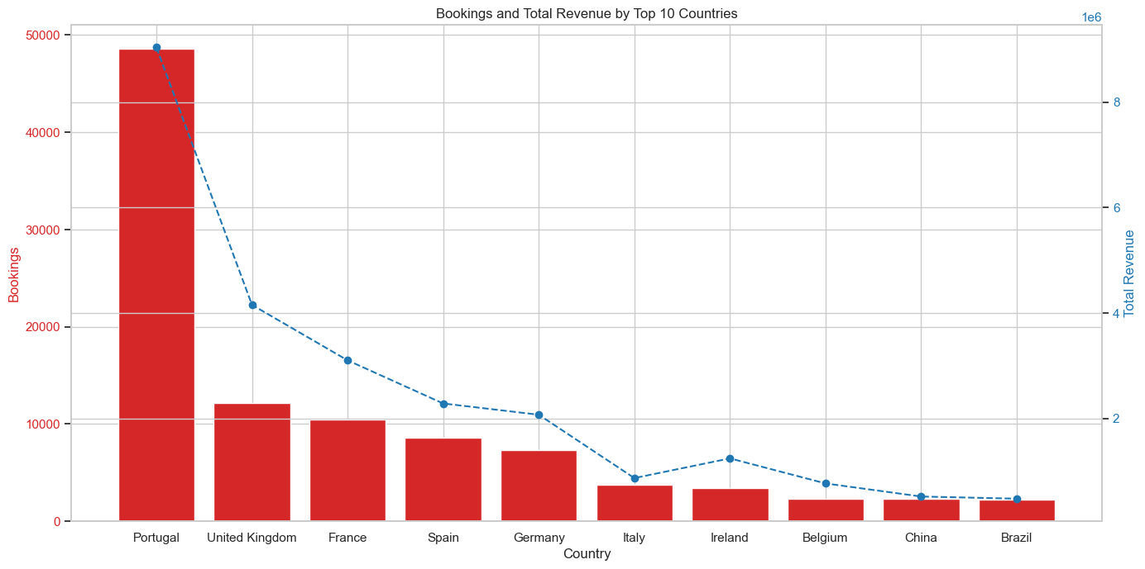
Distribution of guests by country and its impact on revenue

Slide 10
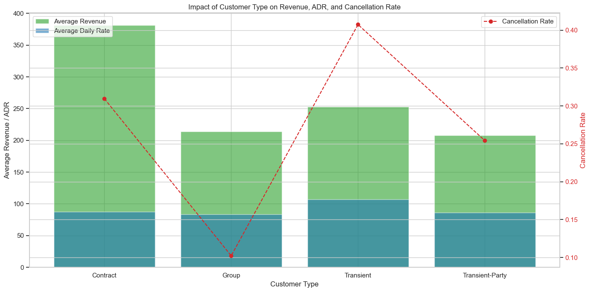
Impact of different customer types on revenue and cancellation rates

Slide 11
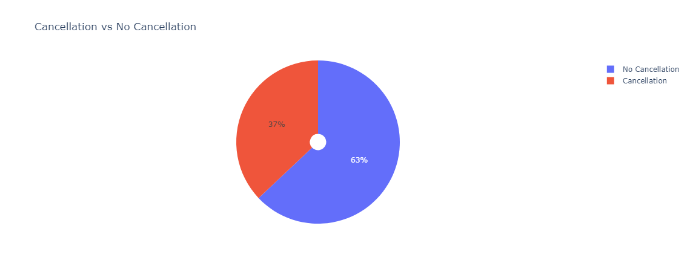
Stay or Stray: Visualizing the Cancellation Story

Slide 12
Model Development

Slide 13
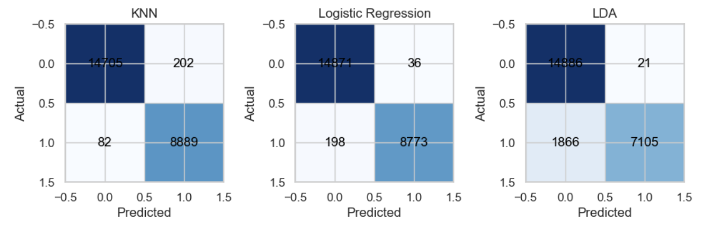
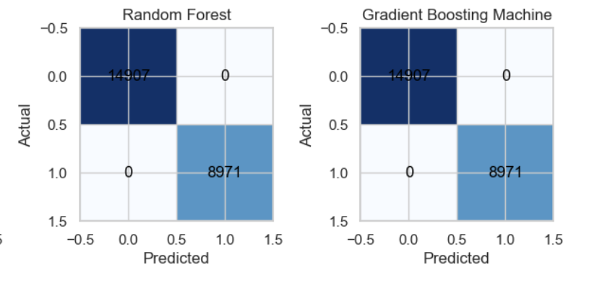
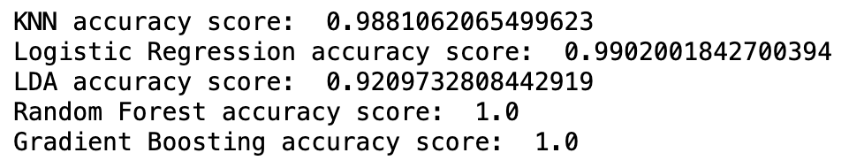
ML Classifiers: Performance Metrics
Accuracies:

Slide 14
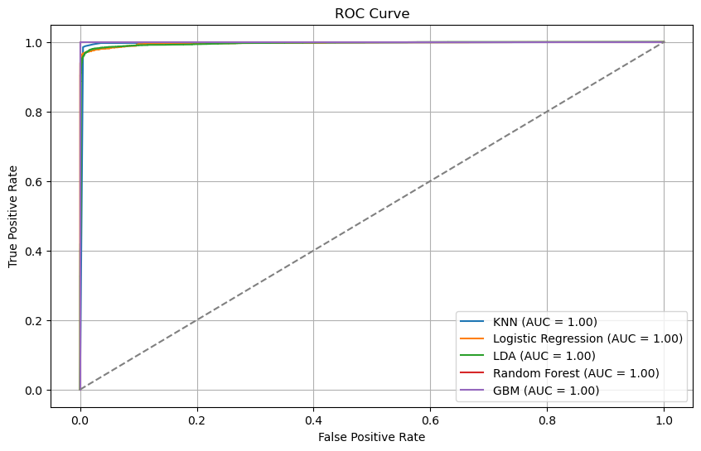
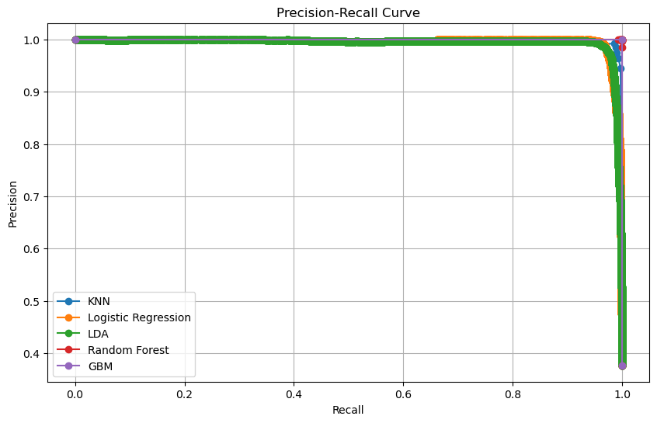
Model Evaluation Metrics

Slide 15
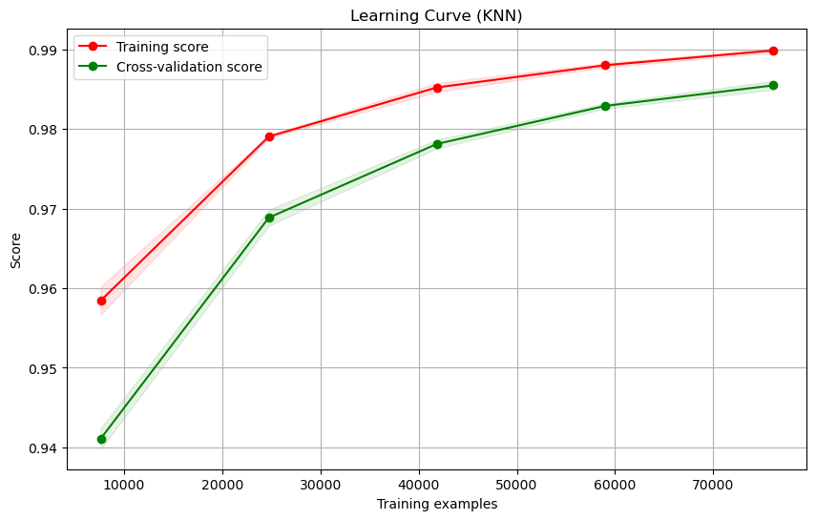
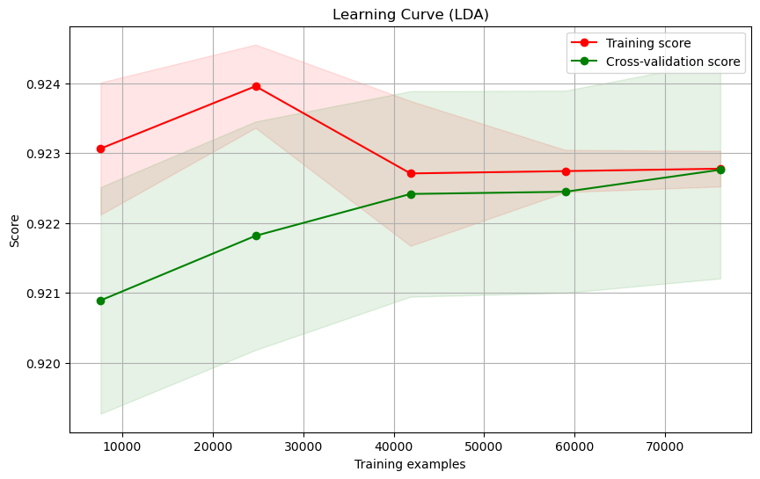
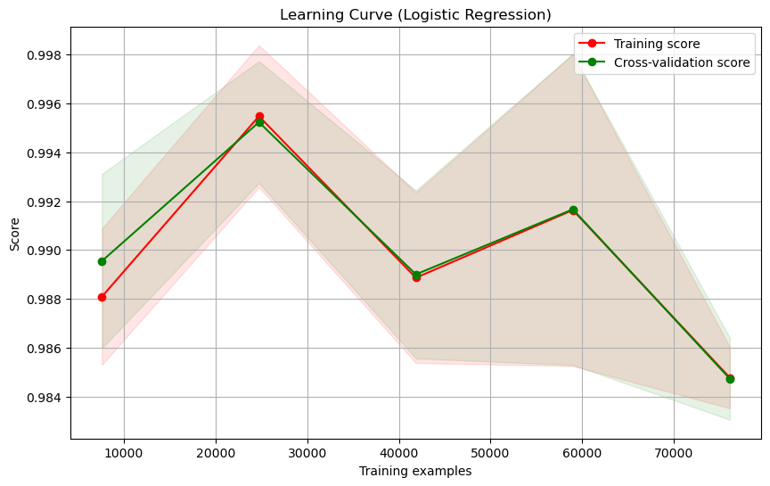
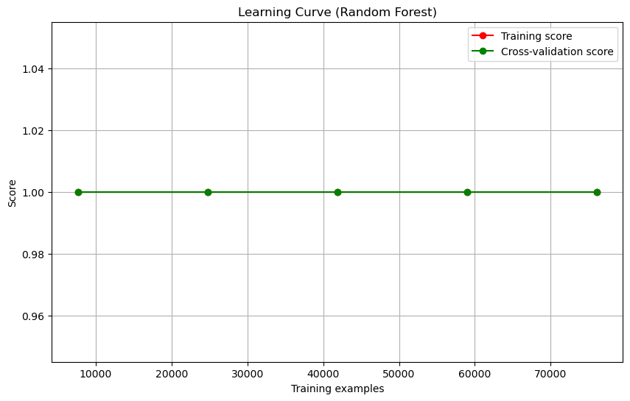
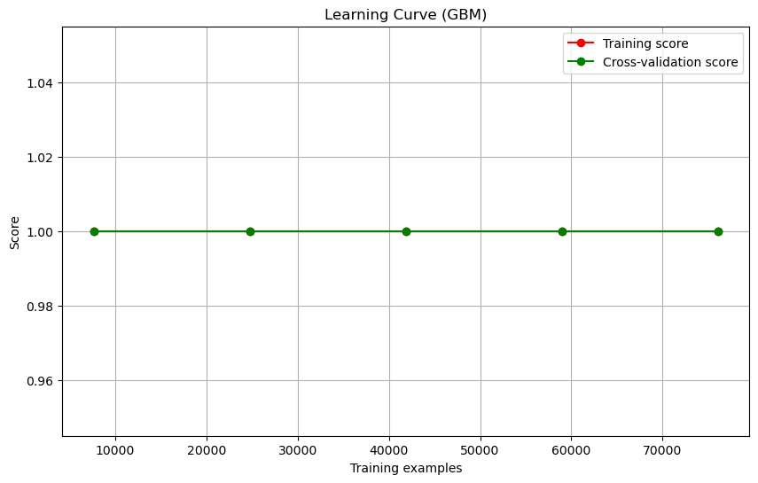
Learning Curve Analysis Across Multiple Models

Slide 16
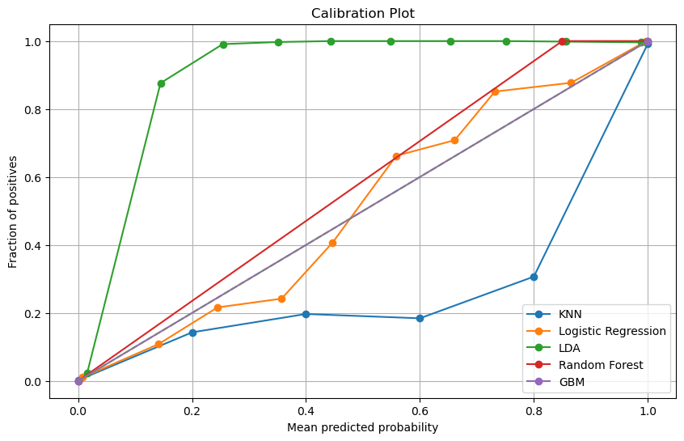
Model Probability Calibration Comparison
GBM and Random Forest show high calibration accuracy.
KNN underestimates positive probabilities.
Logistic Regression and LDA exhibit moderate calibration.

Slide 17
Strategic Playbook: Navigating the Future of Hospitality
Engage Early Birds: Use lead time insights for promotions targeting early bookers. Offer flexible policies for last-minute decisions.
Expand Globally: Use booking data to pinpoint growth areas. Tailor marketing to enter or expand in key markets.
Optimize Pricing: Adjust rates based on distribution channels. Focus on direct bookings to boost margins.
Reduce Cancellations: Refine policies based on cancellation data. Encourage rebookings and provide incentives for confirmed stays.

Slide 18
Unlocking Insights
Lessons from the Data
Planning Insights: Lead time analysis highlighted diverse booking behaviors, guiding targeted marketing and policy adjustments.
Market Opportunities: The global booking map identified potential expansion regions, indicating where to focus next.
Pricing Strategy: ADR analysis by channel underscored the need for tailored pricing and the benefits of direct booking promotion.
Cancellation Insights: Cancellation trends provided a basis for policy refinement, aiming to minimize revenue loss and enhance customer retention.

Slide 19
Thank You
Q & A

